Slide 1


IMPROVING SUCCESS IN TELEMARKETING: AN APPLICATION OF STATISTICAL METHODS IN THE BANKING INDUSTRY
Group - 3
Dimpho Mampuru
Rofhiwa Bulannga
Ongeziwe Kolweni
Supervisor : Dr Rechelle Jacobs
STA 761
Submission date: 04/10/2024

Slide 2

AGENDA
Introduction
1.1 Problem statement
1.2 Objectives
Research design & methodology
Literature Review
Data description
Data preparation
Data analysis
Results
Limitations and recommendations
Conclusion

Slide 3
Aim: Enhance marketing strategies in the banking sector using statistical methods.
Introduction
Problem statement
Direct marketing challenges:
Requires a lot of money and time .
Exhausting to employees and reduces productivity.
Solutions:
Predict phone calls outcome or customer response more accurately.
Improve marketing effectiveness for customers more likely to uptake the long-term deposit.

Slide 4
Objectives
Introduction
Review literature on statistical learning in telemarketing.
Develop two models: Logistic Regression and Decision Tree.
Model Performance evaluation using metrics like: Accuracy, Precision and Recall.
Deliver a comprehensive report, recommendations, and give meaningful insights.

Slide 5
Research design and Methodology
1. Business understanding
2. Data understanding
3. Data preparation
6. Conclusion
5. Model evaluation
4. Modelling

Slide 6
Literature Review
Showed various statistical learning models’(e.g. Logistic regressing, KNN and decision tree) success in predicting customer behaviour Moro et al., 2014.
Significant factors identified - age, job, education, and housing status Tekouabou et al., 2019.
Challenges: data quality, regulatory constraints, and model interpretability Mehrabi et al., 2021.

Slide 7
Data description
Data dimension:
Initial:
(45220 entries,20 variables)
Post data cleaning:
(45211 entries, 19 variables)
Post feature encoding:
(45211 entries, 34 variables)
Summary Statistics
 | Mean | Median | Min | Max
Customer age | 41 | 39 | 18 | 95
Account balance | 1362 | 448 | -8.02 | 102.13
Overdraft limit | 67 | 0 | 0 | 10
Contact attempts | 2.76 | 2 | 1 | 63
Days since previous campaign | 41 | 0 | 0 | 871

Slide 8
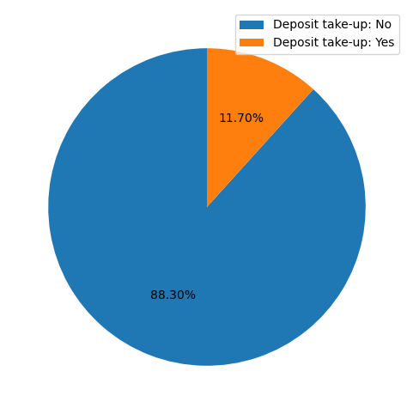
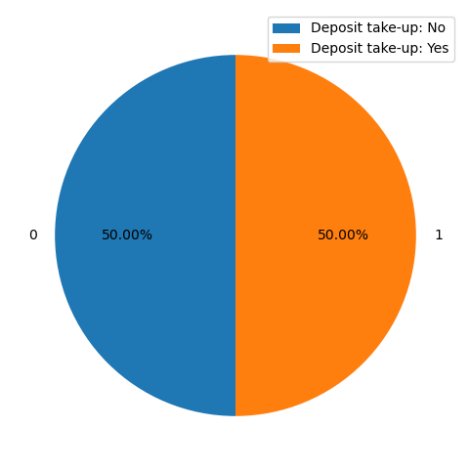
Class distribution: Before and after data balancing
Data preparation
Technique used: Synthetic minority oversampling technique. (Burnaev et al., 2015)
On which data?
The clean data consisting of
45211 entries and 34 variables (after encoding).
Resulting data dimension: 79844 entries and 34 variables , where each class consists of 39922 entries.

Slide 9
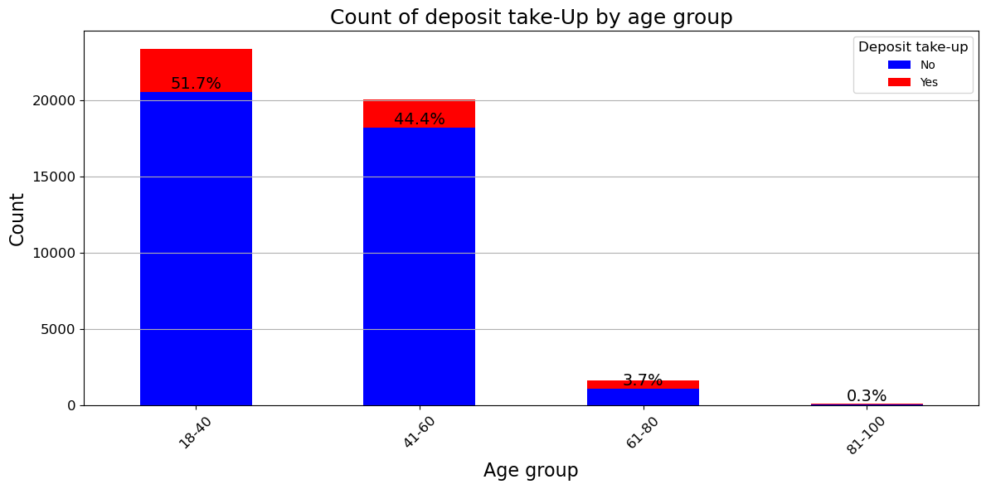
Data analysis
Binning continuous predictors has been shown to be effective in preparing for binary classification (Lund, 2016).
Age group cut-offs align with research goals, such as understanding life stage impacts on deposit take-up.
Across all age groups , people do not have a positive response to the deposit take-up offer.
Most customers are between 18 to 60 (before retirement).
Ages 18-40 have the highest deposit take-ups.

Slide 10
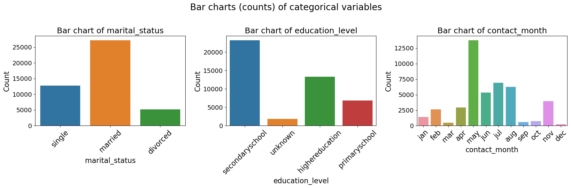
Data analysis
Interesting insights:
Most customers are married, have obtained only secondary education and are contacted in May.

Slide 11
Statistical Analysis and results
Logistic Regression |  |  |  |  | Decision Tree
Overall Accuracy |  | 82% |  |  | Overall Accuracy |  | 79%
CV Training Accuracy |  | 82% |  |  | CV Training Accuracy |  | 79%
CV Test Accuracy |  | 82% |  |  | CV Test Accuracy |  | 79%
ROC AUC score |  | 0.88 |  |  | ROC AUC score |  | 0.83
Classification Report |  |  |  |  | Classification Report
Class 0 |  |  | Class 1 |  | Class 0 |  | Class 1
Precision | Recall |  | Precision | Recall | Precision | Recall | Precision | Recall
81% | 84% |  | 83% | 80% | 85% | 69% | 74% | 88%

Slide 12
Model Comparison
Model Performance: Logistic regression outperforms the decision tree with a ROC AUC score of 89% and 82% accuracy, compared to the decision tree's 83% ROC AUC and 79% accuracy.
Generalization: Logistic regression has better generalization on unseen data due to its ability to capture linear relationship.
Interpretability: Logistic regression provides interpretable coefficients, while decision trees become more complex and harder to interpret as they grow deeper.
Logistic regression excels in predictive power and maintains a balance between generalization and interpretability.
Notes:
In contrast, decision trees can over fit to training data, especially if not properly pruned, which may explain the lower ROC AUC score and accuracy observed in the decision tree.
On the other hand, decision trees provide visual interpretability by illustrating the decision-making process.

Slide 13
Limitations and Recommendations
Limitations
An uneven distribution of observations in the target variable
Only two models compared
Recommendations
Optimize contact timing
Continuous monitoring and updating of models
Balance model complexity and interpretability
Data privacy and security enhancements

Slide 14
Conclusion
Model Comparison: Logistic regression outperformed the decision tree.
Key Predictors: Contact time, previous successful campaigns, and contact type are important factors in predicting deposit acceptance.
Longer contact times and prior successful interactions increase the likelihood of deposit acceptance, helping the bank optimize telemarketing strategies.
Notes:
Strategic Benefits: Prioritizing high-likelihood customers improves resource allocation, reduces costs, and boosts conversion rates.

Slide 15
Questions?

